Slide 1
Lecture 32
Cross Platform Development:-
Introduction to QT
Platform Supported by QT
Modules & Tools of QT,
Unity Engine for Game Development

Slide 2
Lecture 32
Cross Platform Development:-
Introduction to QT
Platform Supported by QT
Modules & Tools of QT,
Unity Engine for Game Development

Slide 3
Need of Cross Platform Development
The world has gone mobile.
One of the most challenging situations for app developers is, whether to develop a native mobile app or go for cross-platform mobile app.
Some organizations can concentrate on only one mobile OS and avoid all the other ones, yet it is important for many businesses to focus with various operating systems.
As a business, you require dealing with different types of customers who possess different types of devices.
Therefore, you need to have a mobile app that could work on almost all the platforms (i.e. Android, iOS, Windows, BlackBerry, etc.)

Slide 4
Cross Platform Development
Cross-platform apps work on multiple operating systems with a single code base.
With careful planning around 50%-80% code can be reused across-platforms. This results in faster development and reduced costs.
Cross-platform development provides more benefits during the maintenance period. If a bug is found in a common codebase it needs to be fixed only once.
You don’t need to learn platform specific development language.
There are 2 types of cross-platform apps:
1. Native Cross-Platform Apps
2. Hybrid ‘HTML5’ Cross-Platform Apps

Slide 5
Native Cross-Platform Apps
Every major mobile operating system has its own SDK to create mobile apps.
These SDKs also have preferred programming languages which are supported by the OS vendor.
For example, for iOS, Objective-C and Swift are the preferred programming languages supported by Apple, whereas for Android, Java is the preferred language supported by Google.
In development of Cross Platform Apps, a third party vendor chooses a programming language and creates a unified API of SDK provided by the various OS vendors.
Popular Native Cross-Platform Frameworks:-
Xamarin
Appcelerator Titanium
NativeScript
QT
RubyMotion

Slide 6
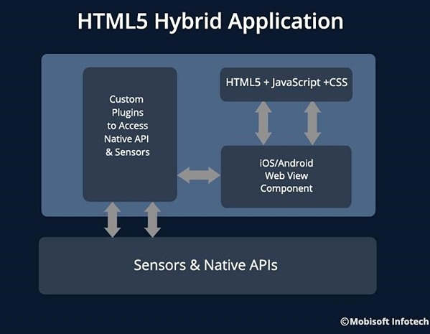
Hybrid ‘HTML5’ Cross-Platform Apps
iOS, Android and Windows Phone, all have a very advanced browser component in their SDKs.
For using this WebView component, programmers are able to use standard HTML5 web technologies to design and program parts of their application.
Most popular hybrid cross-platform framework is Phone-Gap.

Slide 7
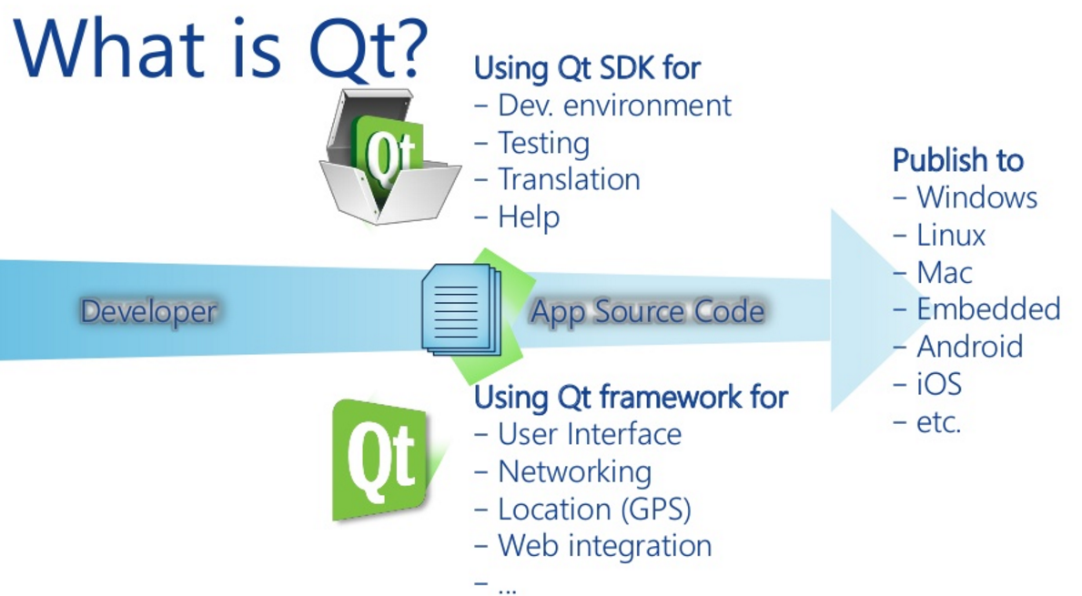
Introduction to QT

Slide 8
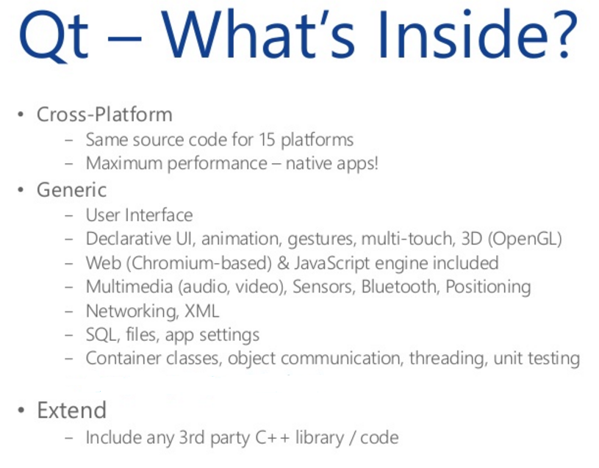
Introduction to QT

Slide 9
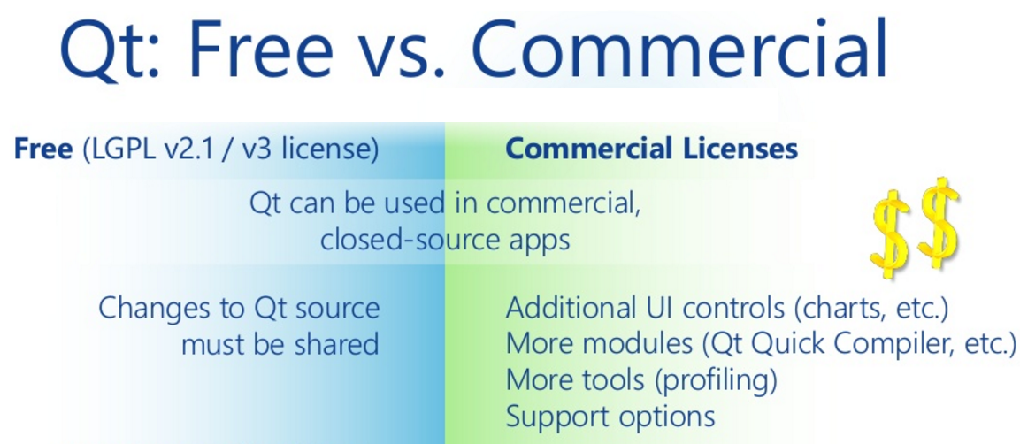
Introduction to QT

Slide 10
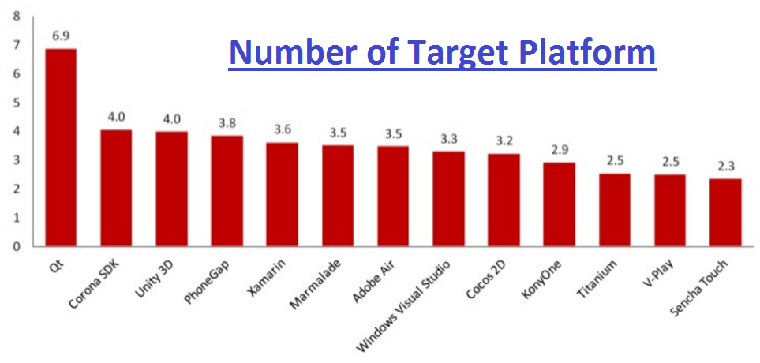
Introduction to QT

Slide 11
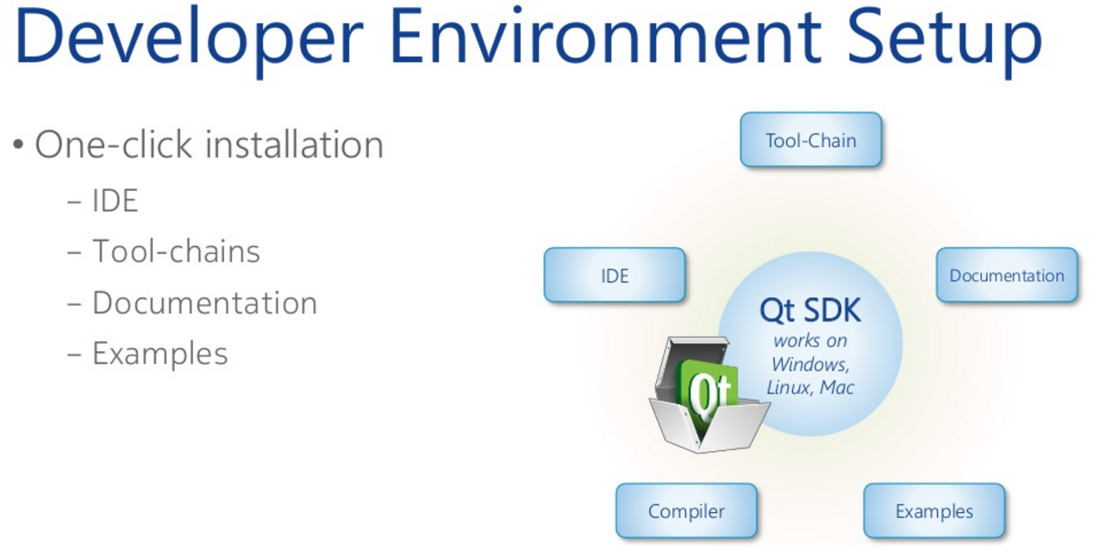
Introduction to QT

Slide 12
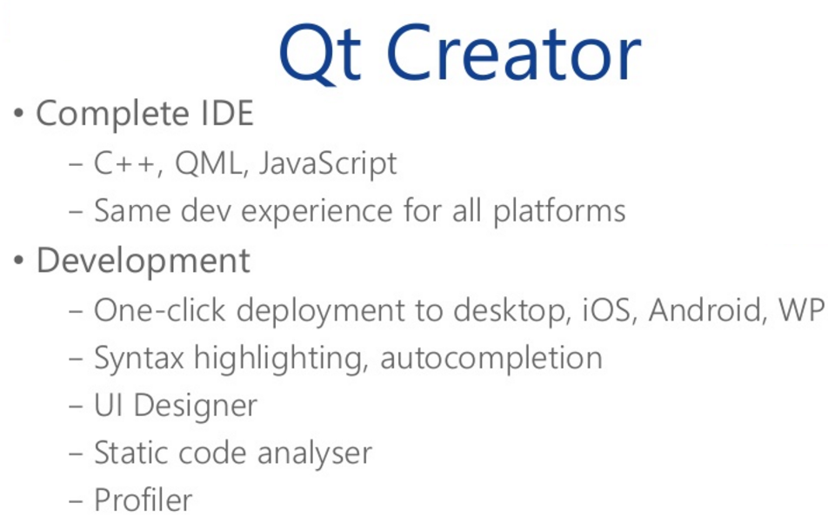
Introduction to QT

Slide 13
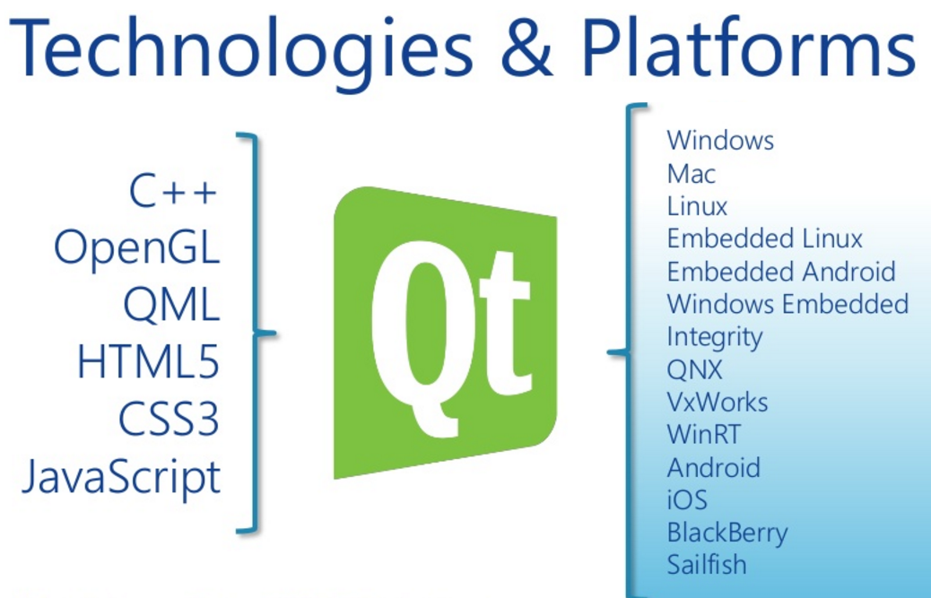
Platforms Supported by QT

Slide 14
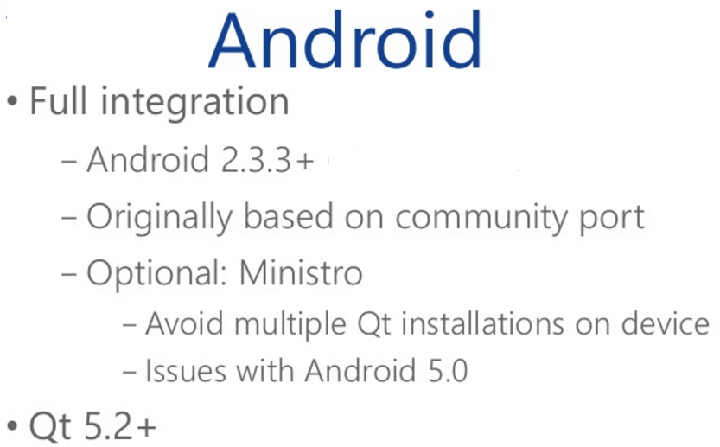
Platforms Supported by QT

Slide 15
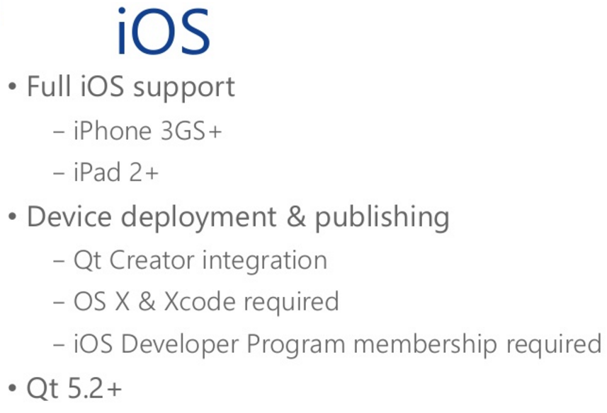
Platforms Supported by QT

Slide 16
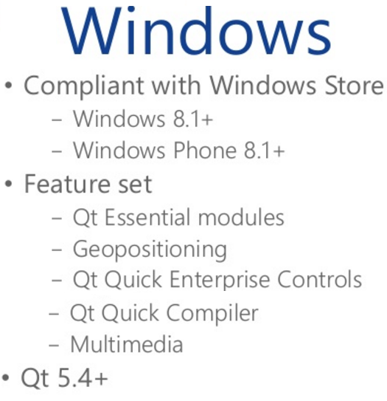
Platforms Supported by QT

Slide 17
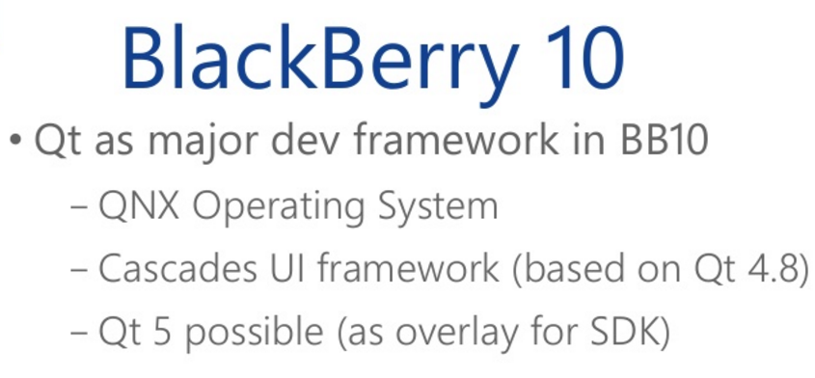
Platforms Supported by QT

Slide 18

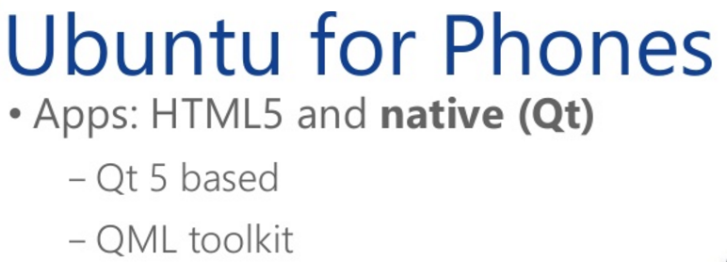
Platforms Supported by QT

Slide 19
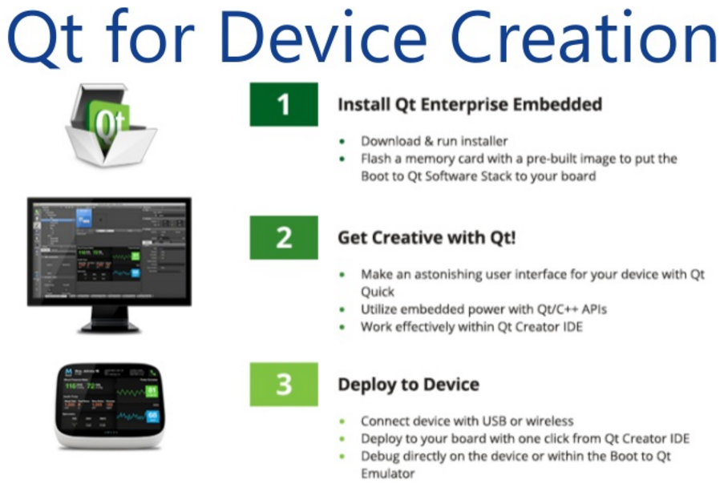
Modules and Tools of QT

Slide 20
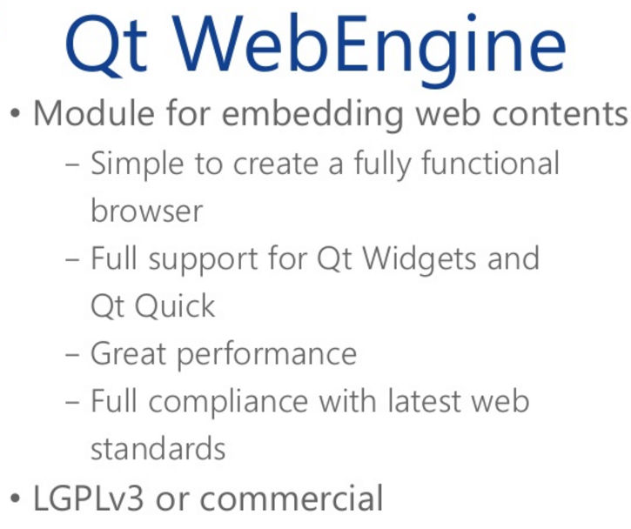
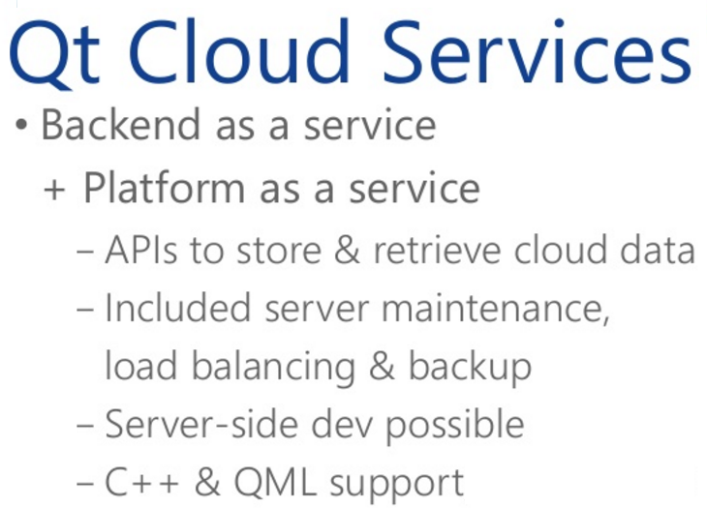
Modules and Tools of QT

Slide 21
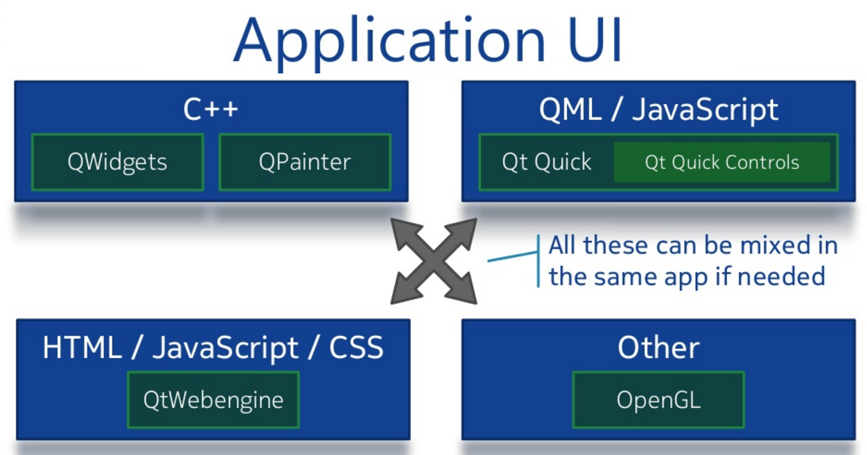
Modules and Tools of QT

Slide 22
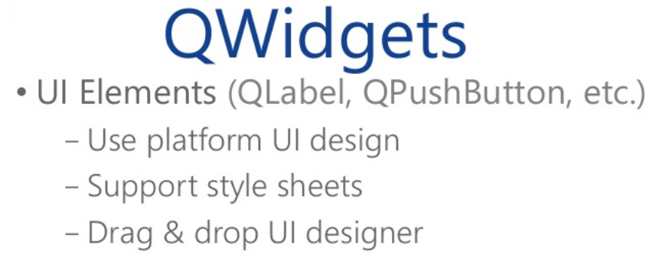
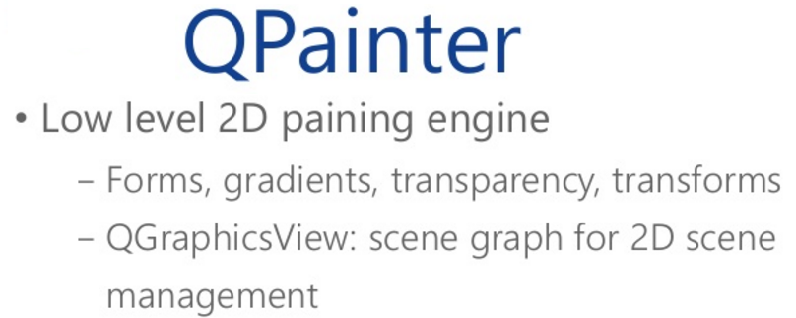
Modules and Tools of QT

Slide 23

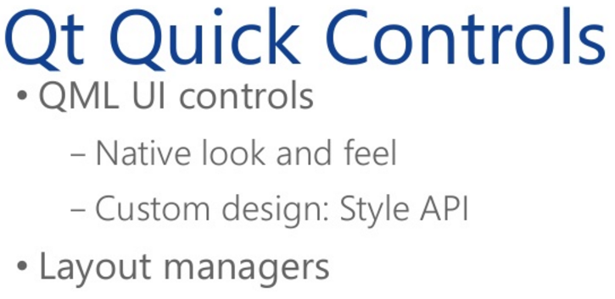
Modules and Tools of QT

Slide 24

Modules and Tools of QT
OpenGL
Basic animation setup provided by QT.
Include OpenGL ES 3.0/3.1
Integration with QtQuick.
Good if you have Cross-Platform.
Pure OpenGL is Hard-Work.

Slide 25
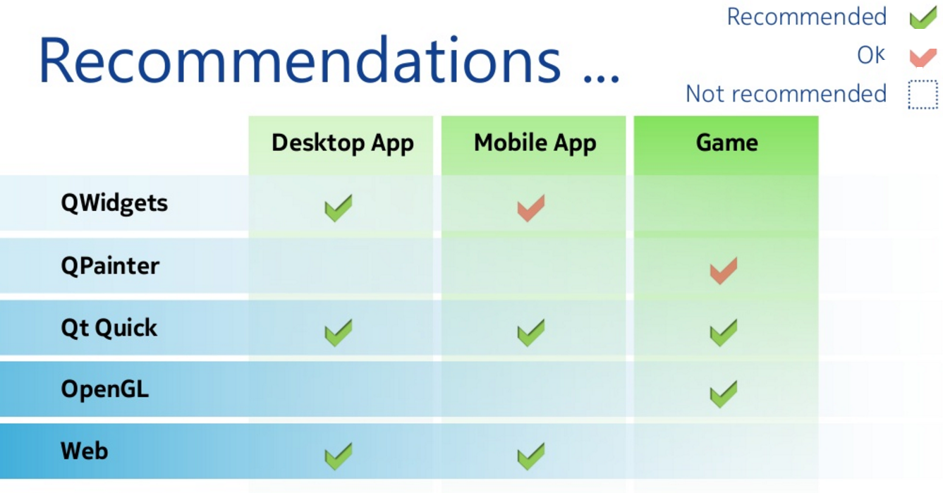
Modules and Tools of QT

Slide 26
Unity Engine for Game Development
Unity is a cross-platform game engine developed by Unity Technologies.
It used to develop video games for PC, mobile devices and websites.
First announced only for Mac OS in 2005.
Now, It works on more than 15 Platforms.
Unity supports both C# and Javascript for game programming.
Unity comes in two basic flavors: the pro version and the free version.

Slide 27
Unity Engine for Game Development
Unity comes with a number of basic view tabs. Like as: Game tab, Scene tab, Inspector tab, Project tab, and Hierarchy tab.
When play button is pressed, then Game tab displays a running object of the game that the user can interact with it.
Scene tab provides a static, editable version of the game-world.
Inspector tab allows the user to modify individual entities in the game world.
Project tab allows the user to browse through the project’s files and drag models, materials, and other resources.
Hierarchy tab shows all objects in the game-world.

Slide 28
Unity Engine for Game Development
Unity Entities:-
Meshes:- Meshes are the way 3D geometry is represented in Unity. The user can either use Unity’s built-in objects (cubes, spheres, cylinders, etc), or import their own 3D models from a modeling package like Blender or Maya. Unity supports a variety of 3D formats, including .fbx, and .3ds.
GUI Elements:- Text can be displayed using the ‘GUI Text’ and the ‘GUI Texture’ GameObjects. However, a more realistic way to handle UI elements is to use the 3D text and Quad GameObjects. GUI elements (text and textures) can have their size and scale adjusted using the relevant fields in the inspector tab.

Slide 29
Unity Engine for Game Development
Unity Entities:-
3. Materials:- Materials are combinations of textures and shaders. Materials can be dragged directly onto game objects from the project tab. You can adjust the texture using the inspector tab.
4. Lights:- If there are no lights in your scene, then it giving the world a ‘flat’ look. Lights can be positioned, rotated, and have several internal characteristics that you can customize.
Three main kinds of light are ‘spot’, ‘point’, and ‘directional’.
Spot lights have a location in 3D space and project light only in one direction.
Point lights have a location in 3D space, and cast light evenly in all directions.
Directional lights affect every object in the scene, and can produce shadows.

Slide 30
Unity Engine for Game Development
Scripting in Unity:-
Once you have a script attached to an object, you can revise it by double clicking on it in the ‘inspector’ tab.
Keywords and comments are highlighted in blue and green, and numerical values and strings appear in red.
If you want a script on an object to affect the properties of a different object, you can create an empty Game-Object variable in your script, and use the inspector tab to assign it to another object in the scene tab.
List of the elements:- Transform, Physics Engine, Cube, Renderer, Collision, Time Correction, Audio Source, Input, Debugging Script etc.

Slide 31
Unity Engine for Game Development
Transform:- The transform functions for a Game-Object in Unity control the physical parameters of that object: its scale, its position, and its orientation. You can access them from within a script like this: transform.position = newPositionValue; transform.rotation = newRotationValue; transform.localScale = newScaleValue;
Renderer:- By using Render, You can re-assign the texture, change the color, and change the shader and visibility of the object.
renderer.enabled = false; renderer.material.color = newColorValue; renderer.material.mainTexture = myTexture; renderer.material.shader = newShaderValue;
Physics Engine:- It allows you to assign the physical properties of objects.

Slide 32
Unity Engine for Game Development
Collision:- When building a game, you’d like a collision to result in some change-of-state in your code, beyond just physics simulation. For this, you’ll need a collision detection method.
Time Correction:- One important factor to keep in mind when you’re manipulating object then do it with frame-rate.
Audio Sources and Listeners:- Unity supports two kinds of sounds: 2D and 3D sounds. 3D sounds vary their volume based on distance. You can use AudioSourceObject.Pause() and AudioSourceObject.Play() to control sound files.
Input:- A game that doesn’t take any input from the user isn’t much of a game. There are a lot of different kinds of input you can read in.
Debugging a Script:- Using it, you can easily find out error if any in your game.

Slide 33
Unity Engine for Game Development
Exploring the Documentation / Learning:-
Unity is a complex engine with Documentation and Learning guide.
This guide will give you a strong starting place for developing a game.
If you’re having trouble with the editor and interface of Unity, there is a long list of high-quality Unity video tutorials and unity text tutorials are also available.
Finally, if you have questions beyond the scope of documentation or tutorials, you can ask specific questions at answers.Unity3d.com.

